Slide 1
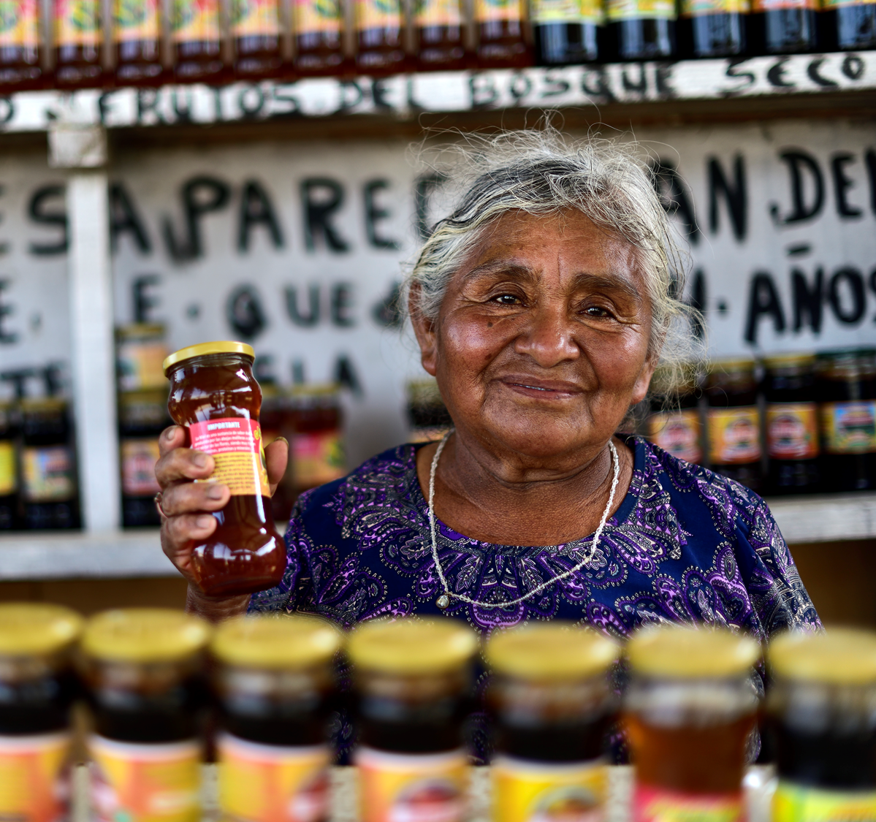

Make a loan, change a life with Lendwithcare
Notes:
Good morning/good afternoon/good evening
My name is X. I work/volunteer for CARE International UK.
CARE is an international development charity that works in over 100 countries around the world. CARE’s projects are designed to help some of the world’s poorest people, and today I’d like to talk to you about an initiative run by CARE called Lendwithcare.

Slide 2
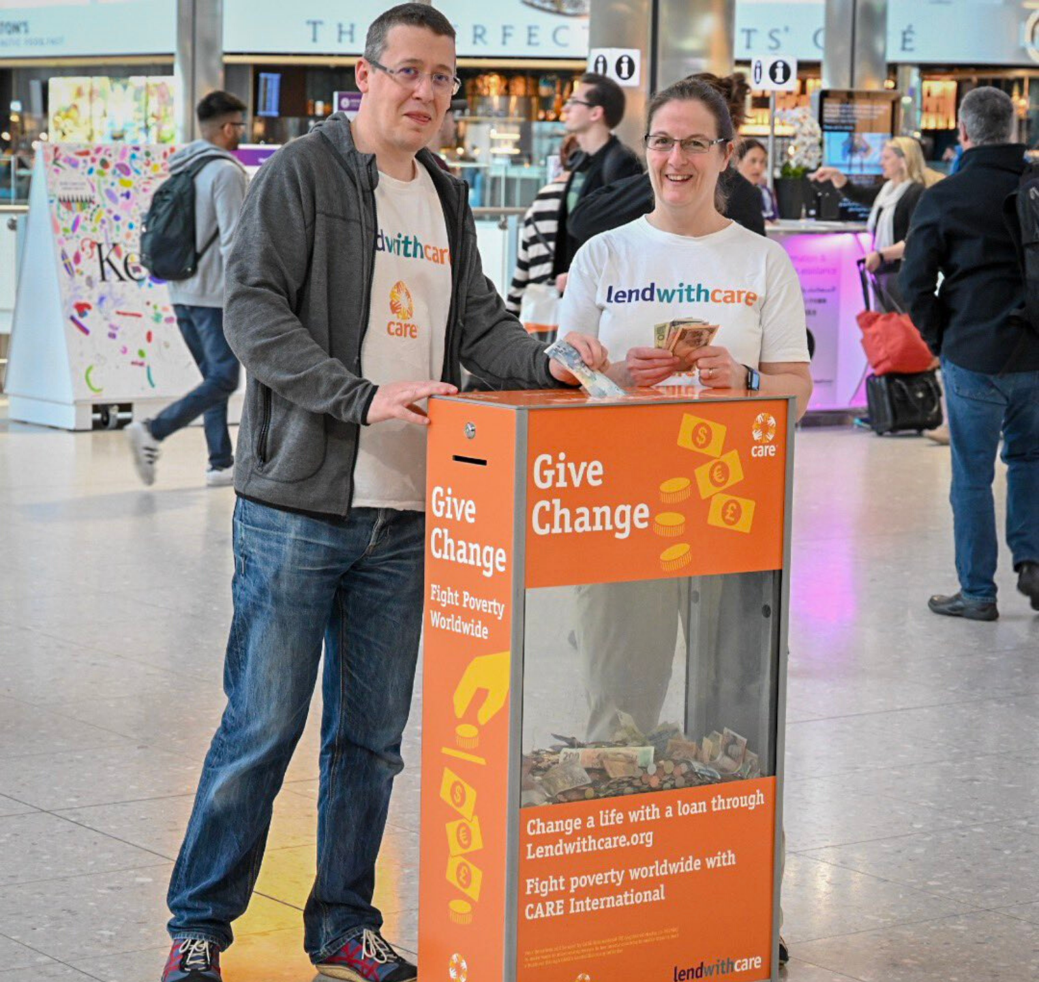
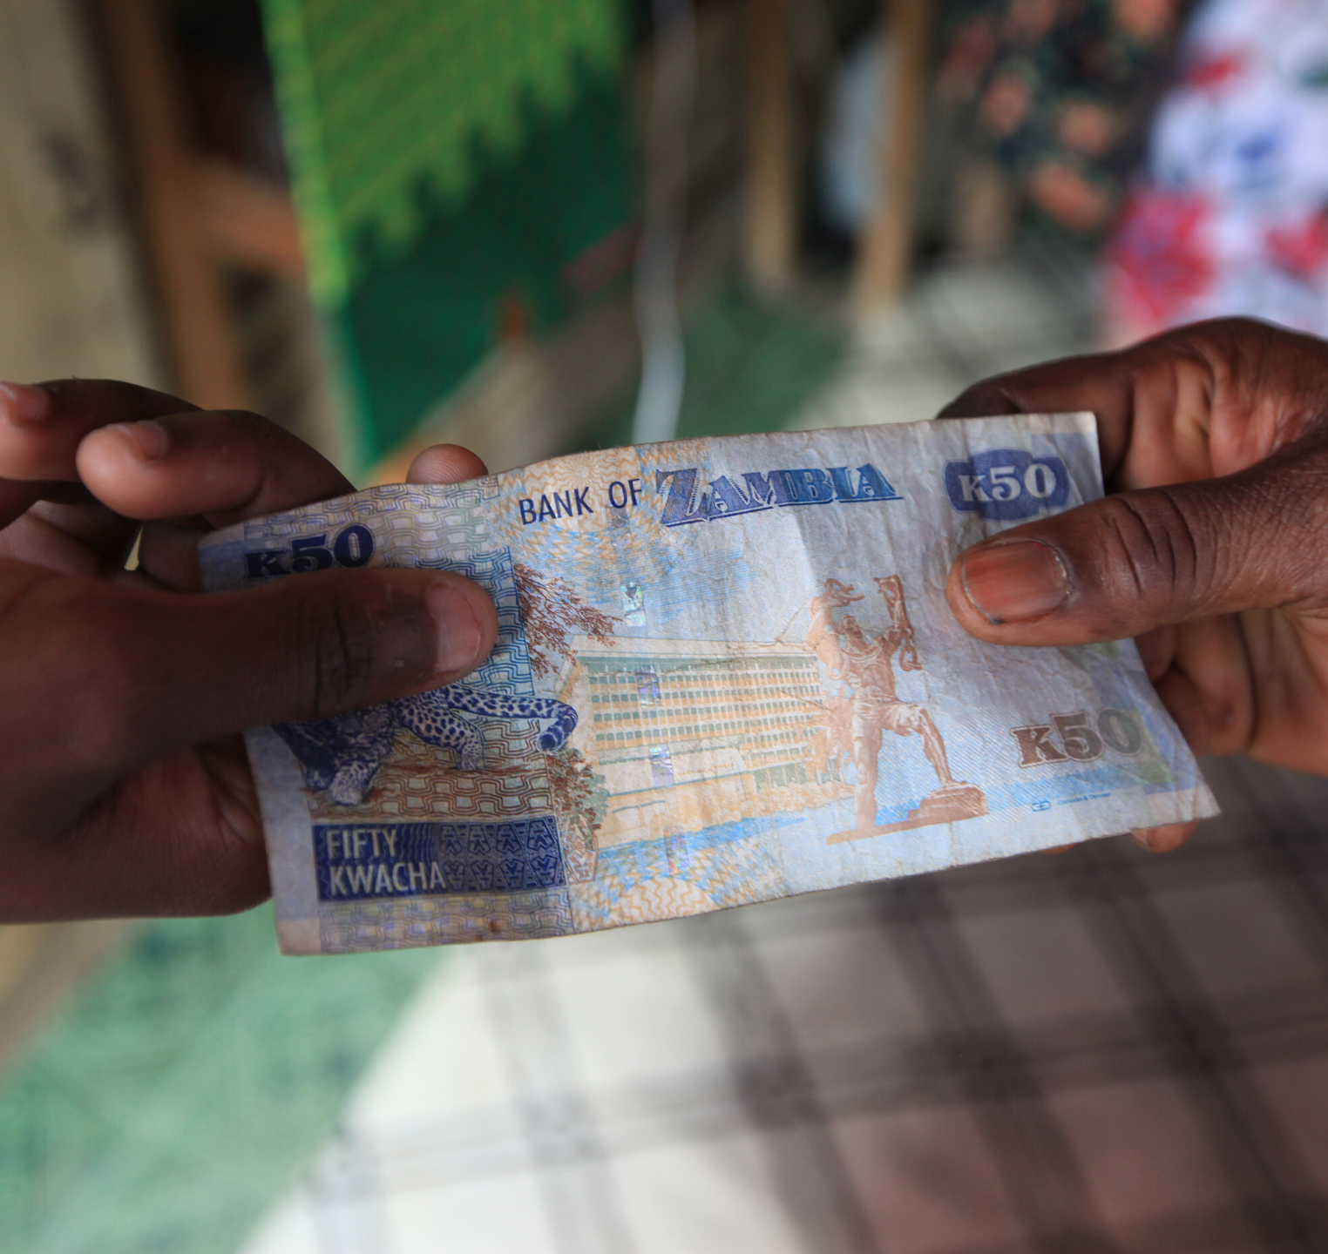
What is the problem we’re aiming to solve?
More than 2 billion people in the world lack access to basic financial services.
It is the poor who are typically excluded from these formal financial services.
Notes:
So, what is the problem that Lendwithcare is aiming to solve?
More than 2 billion people in the world lack access to basic financial services. That means they don’t have a safe place to save money, or access to affordable loans.
It is the poor who are typically excluded from these formal financial services
In some developing countries more than two-thirds of the adult population don’t have access to formal financial services…
Yet the poor need these services and already access them informally through extortionate loan sharks or holding savings under the bed.

Slide 3
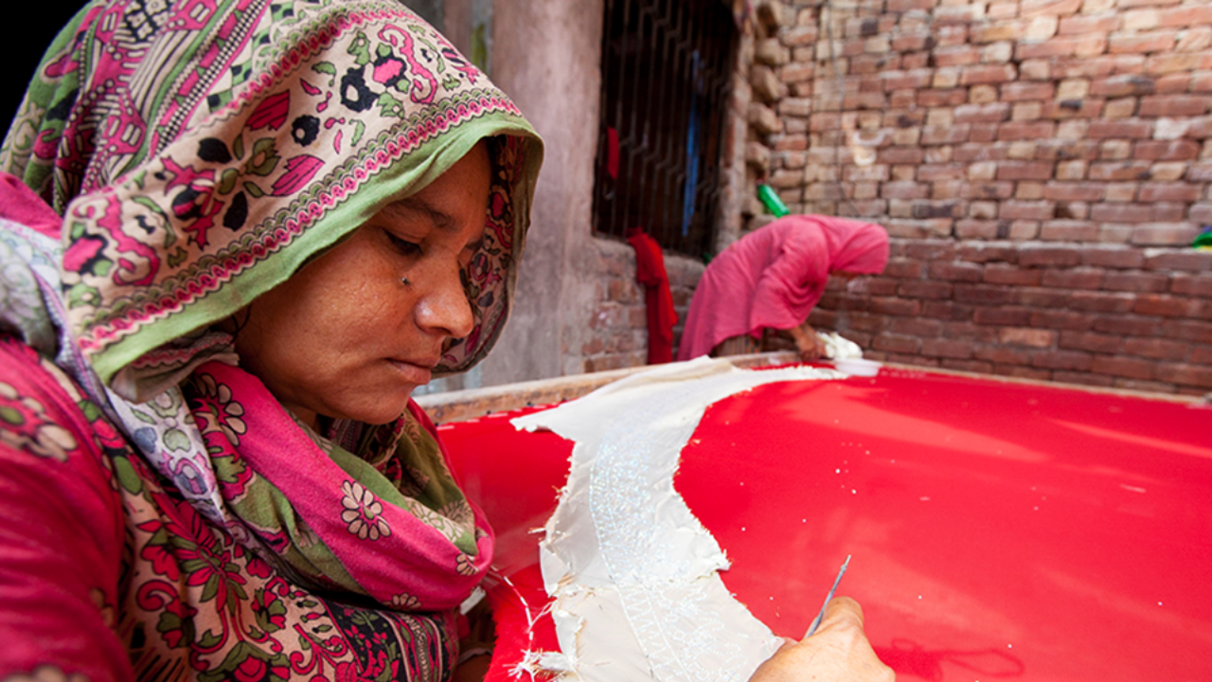
Notes:
Imagine you are a poor man or woman. You don’t have enough money to feed, clothe or educate your children.
Every night you go to bed worrying about how you will feed your children the next day. You worry about their future, whether they will have better opportunities than you have.
The frustrating thing is that you have a skill – you are a talented tailor or seamstress, with a good business idea.
This is Walayat, she lives in Pakistan with her husband and four children.
Like millions of poor people around the world, Walayat has a small business – she is a skilled embroiderer – but lacks funding to help sustain and/or expand her business.
Most banks will not help Walayat because she is poor.
Without the tools to expand her small business, Walayat will struggle to earn a living – creating a permanent barrier to escaping poverty.

Slide 4


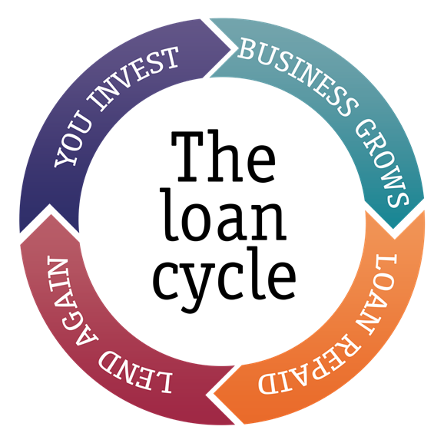
What is Lendwithcare?
Lendwithcare is an initiative from poverty-fighting charity, CARE International UK.
Individuals visit the website – www.lendwithcare.org - and choose an entrepreneur to lend to. They can lend as little as £15 right up to the full loan amount.
Rather than receiving a one-off donation, the entrepreneurs pay their loan back.
Notes:
This is where we come in.
Lendwithcare is an initiative from CARE International UK, which allows individuals to lend small amounts of money (microloans) to entrepreneurs in developing countries to help them grow or expand a small business.
Individuals visit the website – www.lendwithcare.org - and choose an entrepreneur to lend to. They can lend as little as £15 or the full loan.
Rather than receiving a one-off donation, the entrepreneurs pay the loan back to you, using income from their growing business. And once repaid, you can choose to re-lend to another entrepreneur, donate the repayments to CARE or withdraw the money.

Slide 5
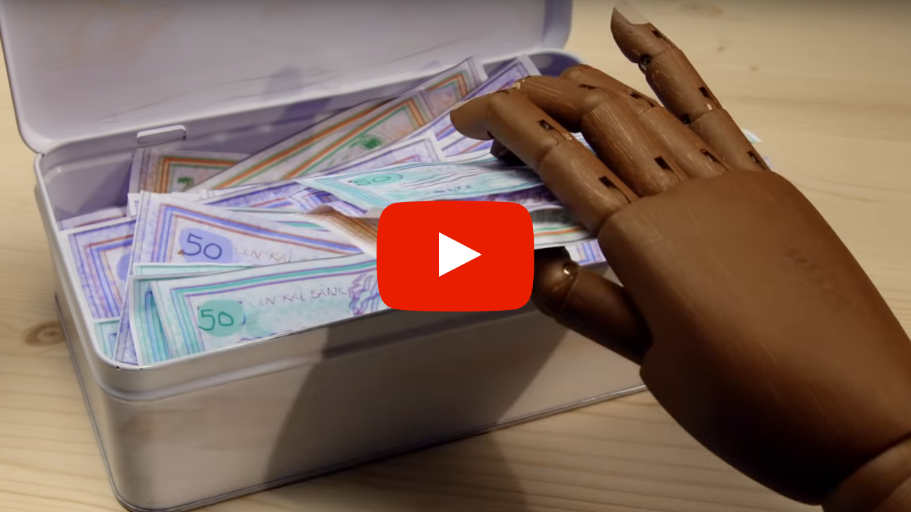
Notes:
I’d like to share a short video with you to illustrate how all of this comes together.
https://youtu.be/xGXOXcLuN2Q
NOTE: An internet connection will be required to play the video. We would recommend having an internet browser open with the video ready to go which you can easily open during the presentation.

Slide 6
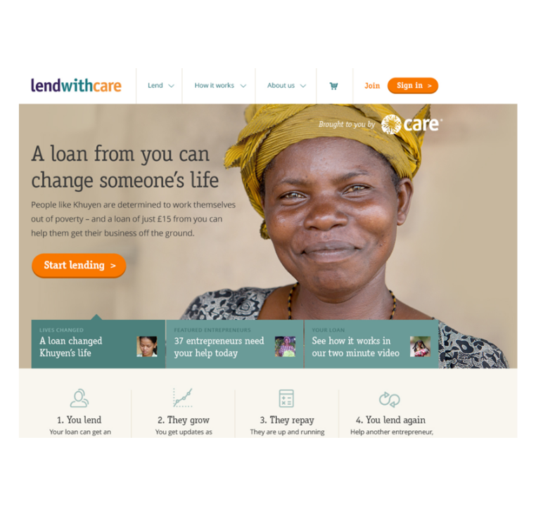
Our website homepage
Simply log on to www.lendwithcare.org where you can view profiles of entrepreneurs all over the world.
You can browse a range of different businesses and choose which entrepreneur or entrepreneurs you'd like to support.
Notes:
Here’s a snapshot of how the website looks.
You simply log on to www.lendwithcare.org where you can view profiles of entrepreneurs all over the world: in Malawi, Zambia, Zimbabwe and Rwanda in Africa, Pakistan, Palestine, the Philippines and Cambodia in Asia, and Ecuador and Peru in South America.
You can view their different businesses and chose which entrepreneur or entrepreneurs you'd like to support. You can invest towards the total, anything from £15 up to the full amount, and you can follow the progress of the entrepreneurs' growing business to see how their new source of income is helping to improve many different aspects of their lives.
The loan is then repaid to you over an agreed schedule, usually about 6-12 months and when the repaid loan is credited to your lendwithcare.org account, you can choose to withdraw the money, or recycle it into another loan and continue your support to entrepreneur after entrepreneur.
NOTE: Please keep an eye on the website to update the list of countries Lendwithcare is operating in.

Slide 7
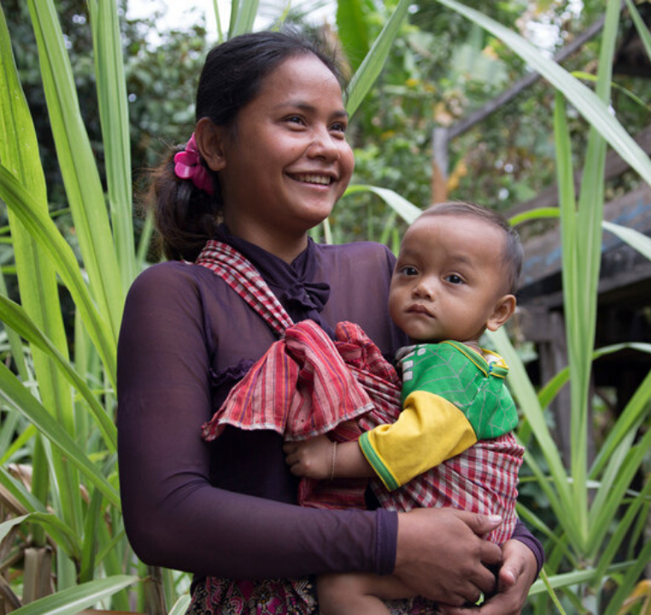
Make a loan, change a life with Lendwithcare
Thank you. Please visit the website to find out more!
Notes:
Right now there are 60,000 people across the UK just like you who are helping nearly 130,000 poor entrepreneurs like Walayat, all around the world every day.
So far our amazing supporters have helped to lend an incredible £27million and the figure is growing every day.
I sincerely hope you will all join us. You can find out more by going to the website lendwithcare.org.
Thanks for listening.

