Slide 1
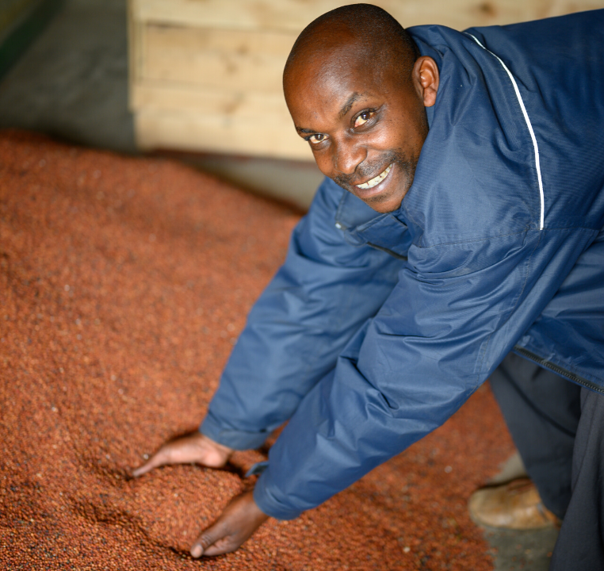

Make a loan, change a life with Lendwithcare
Notes:
Hello!
My name is X. I work/volunteer for a charity called CARE International UK. I’m here to talk to you about what we do, and how you and your family can help.
Our charity is called CARE International.
Can anyone guess:
What we do?
Where we work?
Who we help?
Great! So CARE works in over 100 different countries around the world. We run lots of different projects to help some of the world’s poorest people, one of which is something called Lendwithcare.

Slide 2
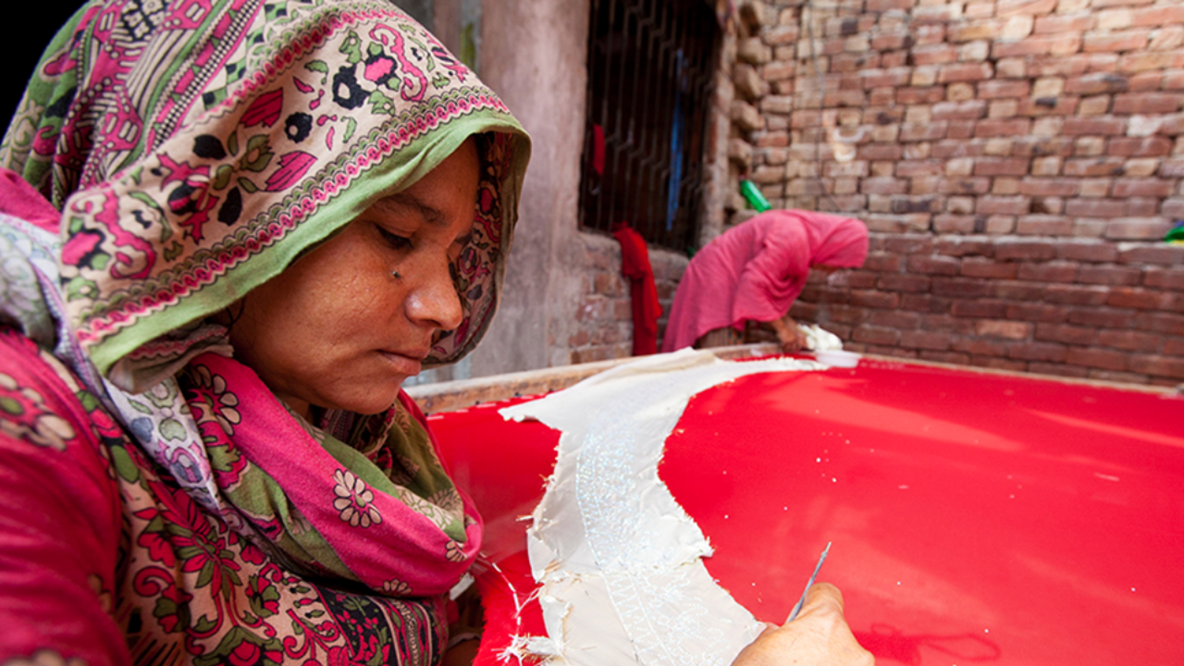
Notes:
This is Walayat, she is one of the people we’ve helped.
Can anyone guess where Walayat lives?
Can anyone guess what Walayat does? What do you think her job is?
So Walayat has a problem. She’s very talented and can make beautiful clothes. She wants to start her own business sewing clothes so she can make money to buy food for her family and send her four children to school.
But because Walayat is poor, she has no money to start this business, and the banks won’t help her.

Slide 3
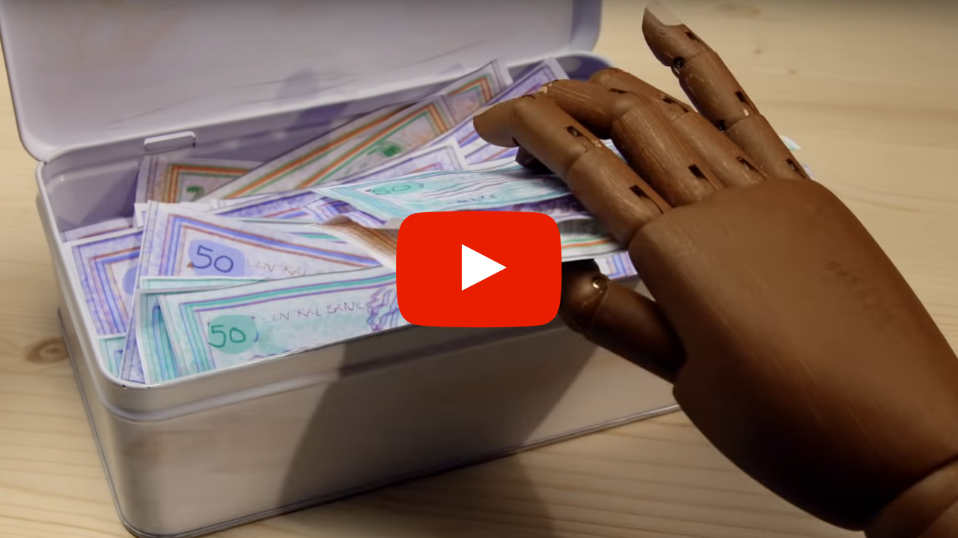
Notes:
And this is where Lendwithcare helps, and where you can all help too! Here’s a short video to explain everything.
https://youtu.be/xGXOXcLuN2Q
NOTE: An internet connection will be required to play the video. We would recommend having an internet browser open with the video ready to go which you can easily open during the presentation.

Slide 4
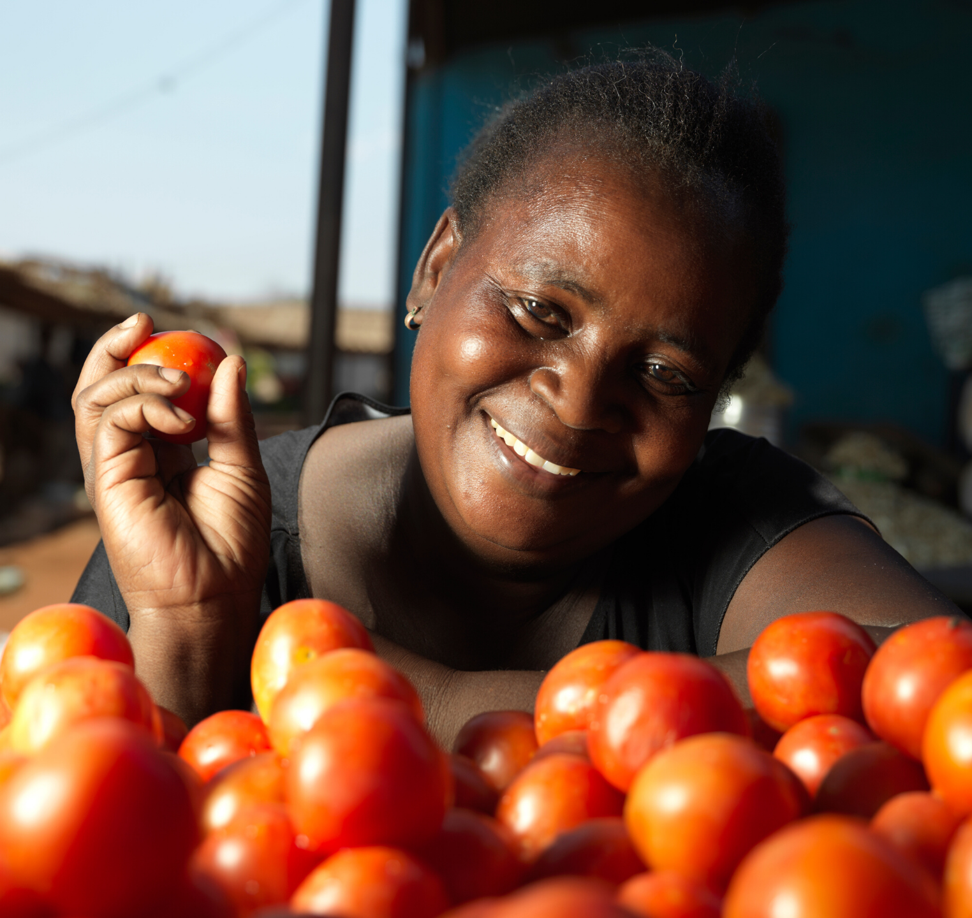

Elina, Tomato Seller
This is Elina.
She sells tomatoes from her market stall so she can afford to send her children to school. She wants to borrow some money so she can buy more tomatoes for her stall.
Where do you think Elina is from?
Notes:
This is Elina.
She sells tomatoes from her market stall so she can afford to send her children to school. She wants to borrow some money so she can buy more tomatoes for her stall.
Can anyone guess where Elina is from?
What a great guess! Elina is from Zambia in Africa, that’s over 5,000 miles away from the UK!
NOTE: Run through the timings beforehand to reveal the country flag at the right time.

Slide 5
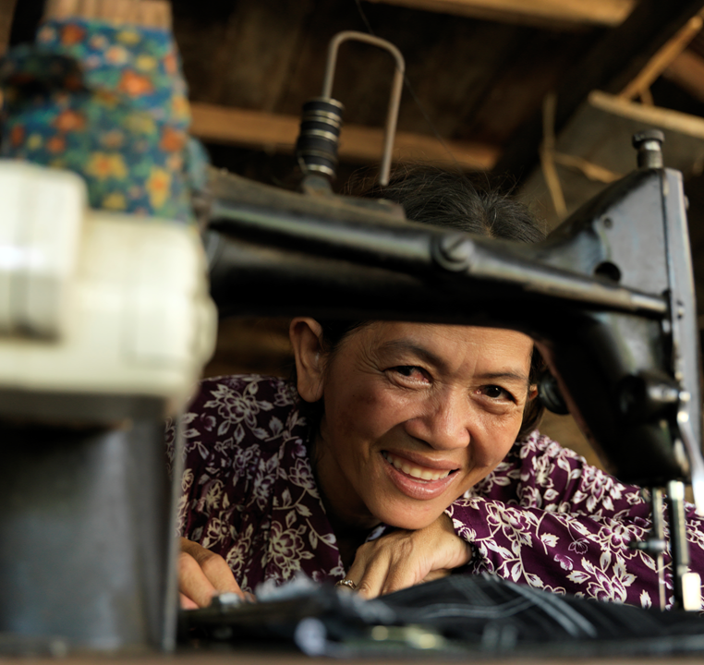

La Morm, Seamstress
This is La Morm.
Like Rasheeda, she sews clothes. She wants to borrow some money so she can buy another sewing machine and employ someone to work for her.
Where do you think La Morm is from?
Notes:
This is La Morm.
Like Walayat who we met at the start of the presentation, she sews clothes. She wants to borrow some money so she can buy another sewing machine and employ someone to work for her.
Where do we think La Morm is from? Would anyone like to take a guess?
Another excellent guess! La Morm is from Cambodia, that’s in Asia. Cambodia is really close to Thailand and Vietnam.
NOTE: Run through the timings beforehand to reveal the country flag at the right time.

Slide 6
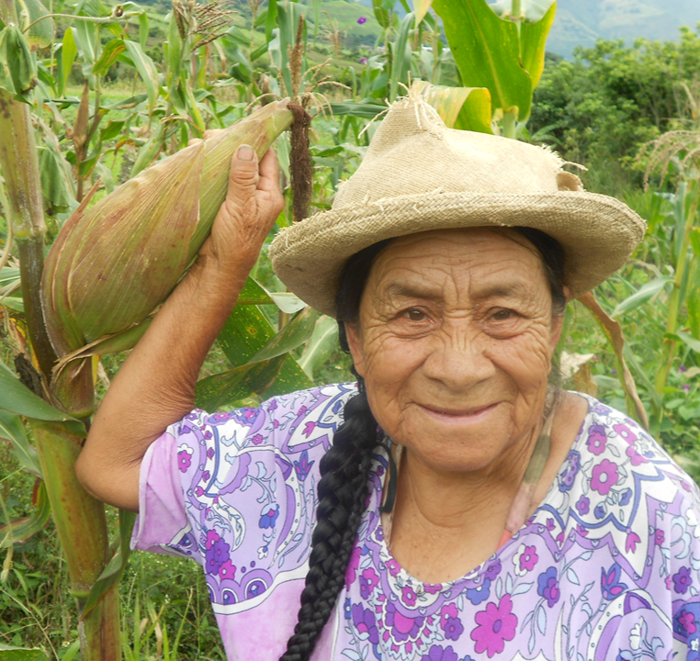

Leonor, Corn Farmer
This is Leonor.
She is a farmer growing corn. Leonor is quite old and has health problems. She wants to borrow money so she can grow her farm and pay for her medical care.
Where do you think Leonor is from?
Notes:
Finally, this is Leonor.
She is a farmer growing corn. Leonor is quite old and has health problems. She wants to borrow money so she can grow her farm and pay for her medical care.
Any guesses as to where Leonor is from?
Wow, you all really know your geography! Leonor is from Ecuador in South America. As you might guess, that is south of the United States of America. About 2,900 miles south in fact!
NOTE: Run through the timings beforehand to reveal the country flag at the right time.

Slide 7

Who would you choose?
Imagine your class has £15, and you can choose which of these women you want to lend that money to. Would you…
Help Elina and her market stall?
Help La Morm and her sewing business?
Help Leonor grow more corn to pay for medical care?
Notes:
Imagine your class has £15, and you can choose which of these women you want to lend that money to, to help them grow their business.
Who would choose Marcelline and her market stall, in Benin? (Ask one person why)
Who would choose Leonor and her corn farm, in Ecuador? (Ask one person why)
Who would choose La Morm and her sewing workshop, in Cambodia? (Ask one person why)
And the best part about Lendwithcare is that every month, the person you lend your money to will pay that money back to you, bit by bit. So once you have your £15 back again, you can choose a brand new person to help, over and over again!

Slide 8
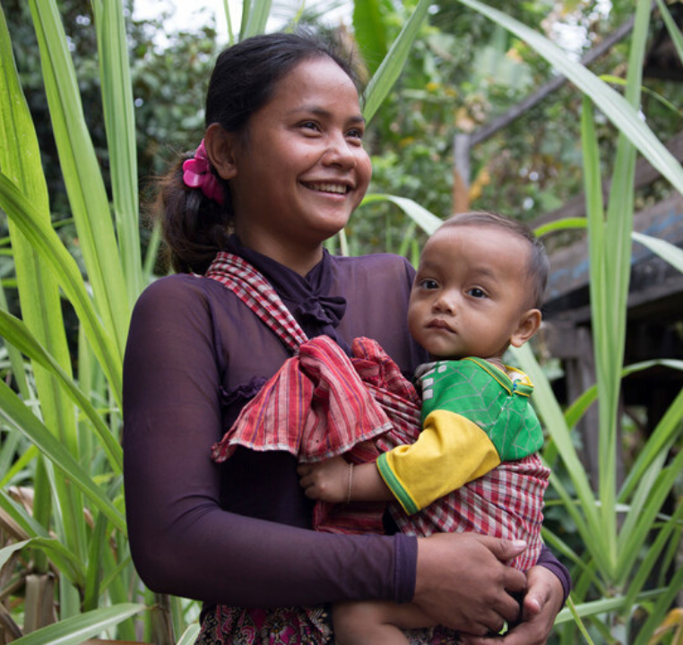
Make a loan, change a life with Lendwithcare
Thank you. Please visit the website to find out more!
Notes:
Right now there are 60,000 people in the country like you who are helping nearly 130,000 poor entrepreneurs just like Walayat, like Elina, like La Morm and like Leonor, all around the world every day.
So far our amazing supporters have helped to lend £27million!
I hope you will all join us and help even more poor people like the ladies we have talked about today. Even a loan of £15 can help to make a big difference in their lives.
You can find out more by going to the website lendwithcare.org.

