Slide 1
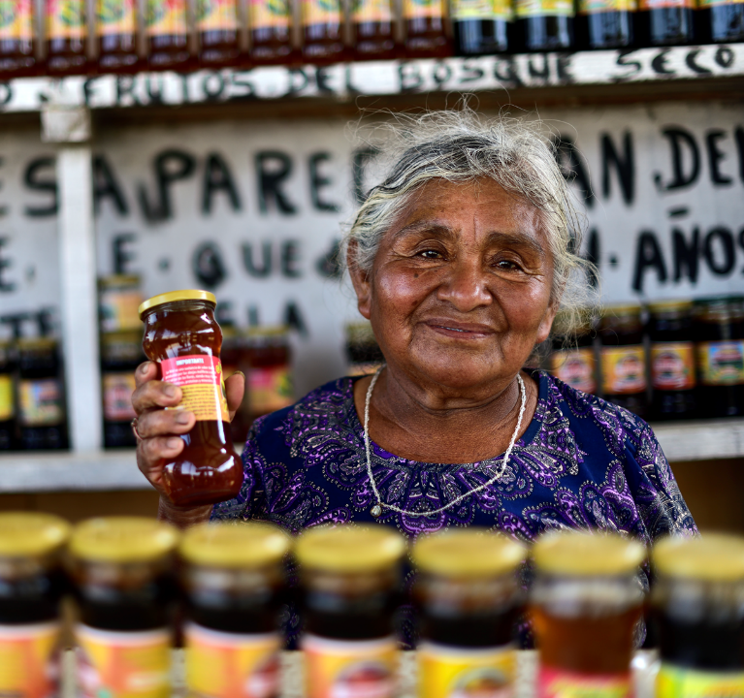

Make a loan, change a life with Lendwithcare
Notes:
Good morning/good afternoon/good evening
My name is X. I work/volunteer for CARE International UK.
CARE is an international development charity that works in over 100 countries around the world. CARE’s projects are designed to help some of the world’s poorest people, and today I’d like to talk to you about an initiative run by CARE called Lendwithcare.

Slide 2
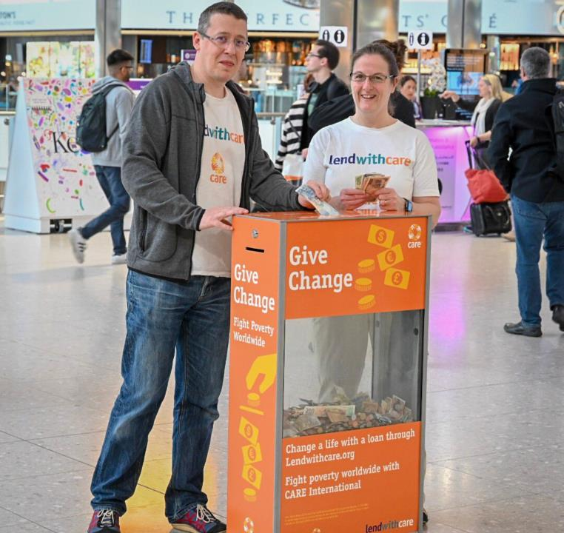
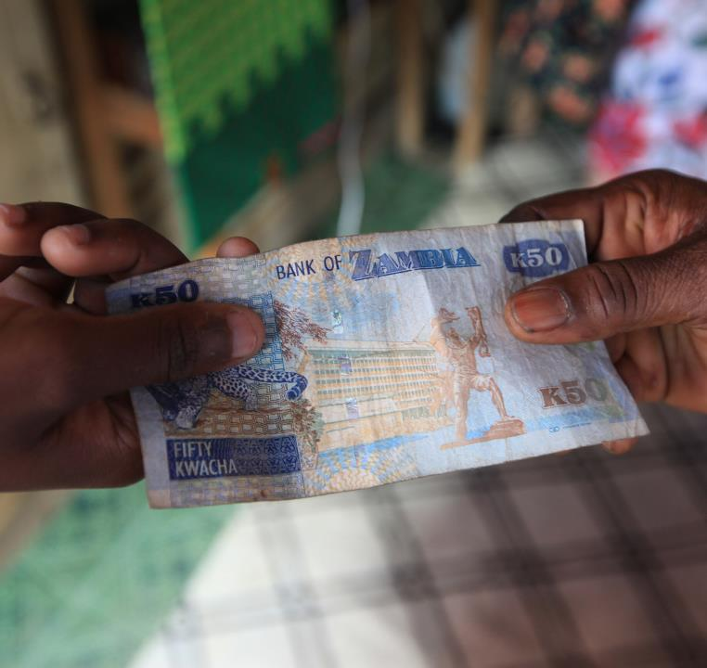
What is the problem we’re aiming to solve?
More than 2 billion people in the world lack access to basic financial services.
It is the poor who are typically excluded from these formal financial services.
Notes:
So, what is the problem that Lendwithcare is aiming to solve?
More than 2 billion people in the world lack access to basic financial services. That means they don’t have a safe place to save money, or access to affordable loans.
It is the poor who are typically excluded from these formal financial services
In some developing countries more than two-thirds of the adult population don’t have access to formal financial services…
Yet the poor need these services and already access them informally through extortionate loan sharks or holding savings under the bed.

Slide 3
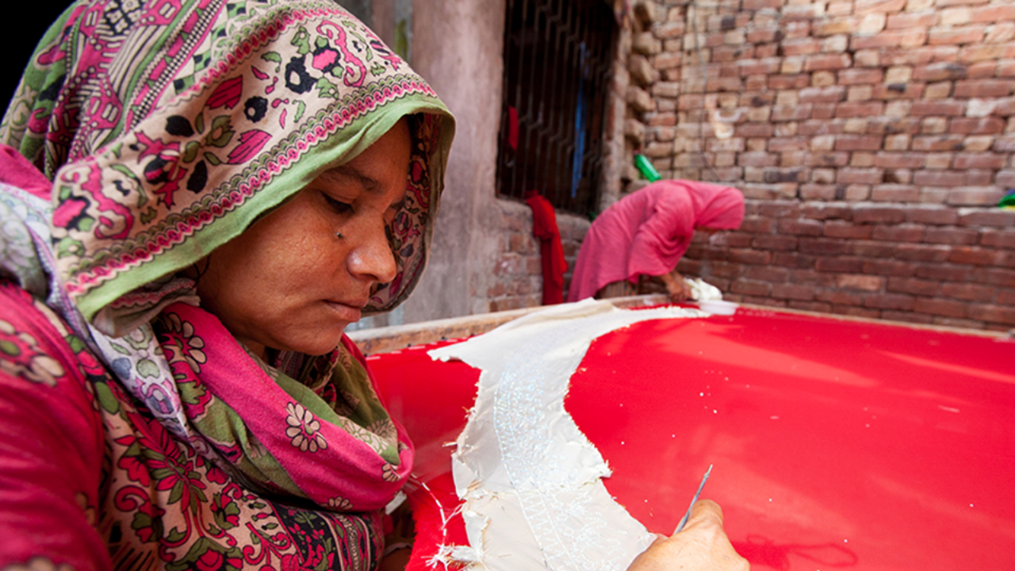
Notes:
Imagine you are a poor man or woman. You don’t have enough money to feed, clothe or educate your children.
Every night you go to bed worrying about how you will feed your children the next day. You worry about their future, whether they will have better opportunities than you have.
The frustrating thing is that you have a skill – you are a talented tailor or seamstress, with a good business idea.
This is Walayat, she lives in Pakistan with her husband and four children.
Like millions of poor people around the world, Walayat has a small business – she is a skilled embroiderer – but lacks funding to help sustain and/or expand her business.
Most banks will not help Walayat because she is poor.
Without the tools to expand her small business, Walayat will struggle to earn a living – creating a permanent barrier to escaping poverty.

Slide 4

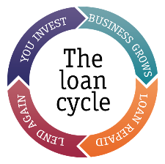
What is Lendwithcare?
Lendwithcare is an initiative from poverty-fighting charity, CARE International UK.
Individuals visit the website – www.lendwithcare.org - and choose an entrepreneur to lend to. They can lend as little as £15 right up to the full loan amount.
Rather than receiving a one-off donation, the entrepreneurs pay their loan back.
Notes:
This is where we come in.
Lendwithcare is an initiative from CARE International UK, which allows individuals to lend small amounts of money (microloans) to entrepreneurs in developing countries to help them grow or expand a small business.
Individuals visit the website – www.lendwithcare.org - and choose an entrepreneur to lend to. They can lend as little as £15 or the full loan.
Rather than receiving a one-off donation, the entrepreneurs pay the loan back to you, using income from their growing business. And once repaid, you can choose to re-lend to another entrepreneur, donate the repayments to CARE or withdraw the money.

Slide 5
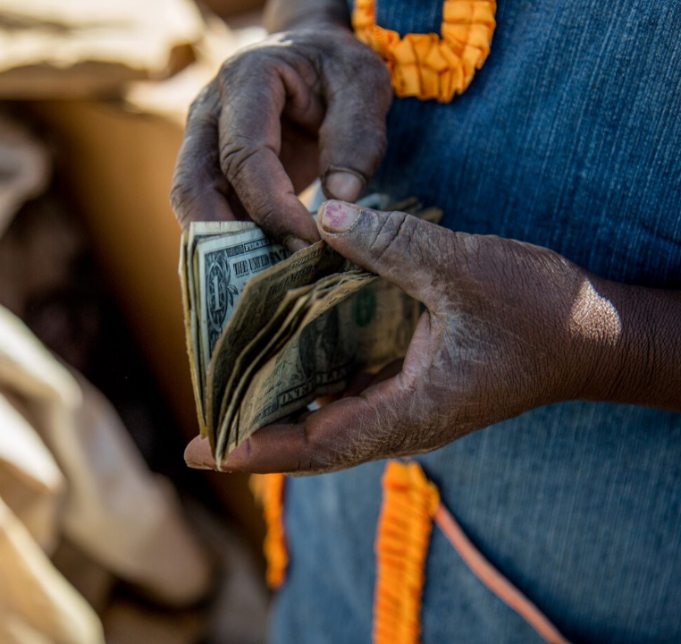
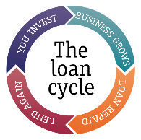
What is microfinance?
Microfinance is the provision of financial services for low-income people. This includes microloans, savings, micro-insurance, money transfers and financial training.
CARE believes that fair and effective financial services are central to addressing poverty.
Notes:
What is microfinance?
Microfinance is the provision of financial services for low-income people. This includes microloans, savings, micro-insurance, money transfers and financial training.
Microfinance is usually provided through specialist microfinance institutions (MFIs) rather than commercial banks.
CARE believes that fair and effective financial services are central to addressing poverty.
CARE has seen in the three decades it’s been working in microfinance that providing people with appropriate financial tools and training can have a transformative effect on their lives – helping the poorest earn a living, grow businesses and create new jobs. Since 2011, 1.2 billion people have opened a bank account.
If not delivered well, it can worsen economic and social situations and result in, for example, over-indebtedness and worsening gender relations. Lendwithcare therefore has a strong focus on due diligence and monitoring and evaluation to ensure a positive impact on the lives of those living in poverty.

Slide 6
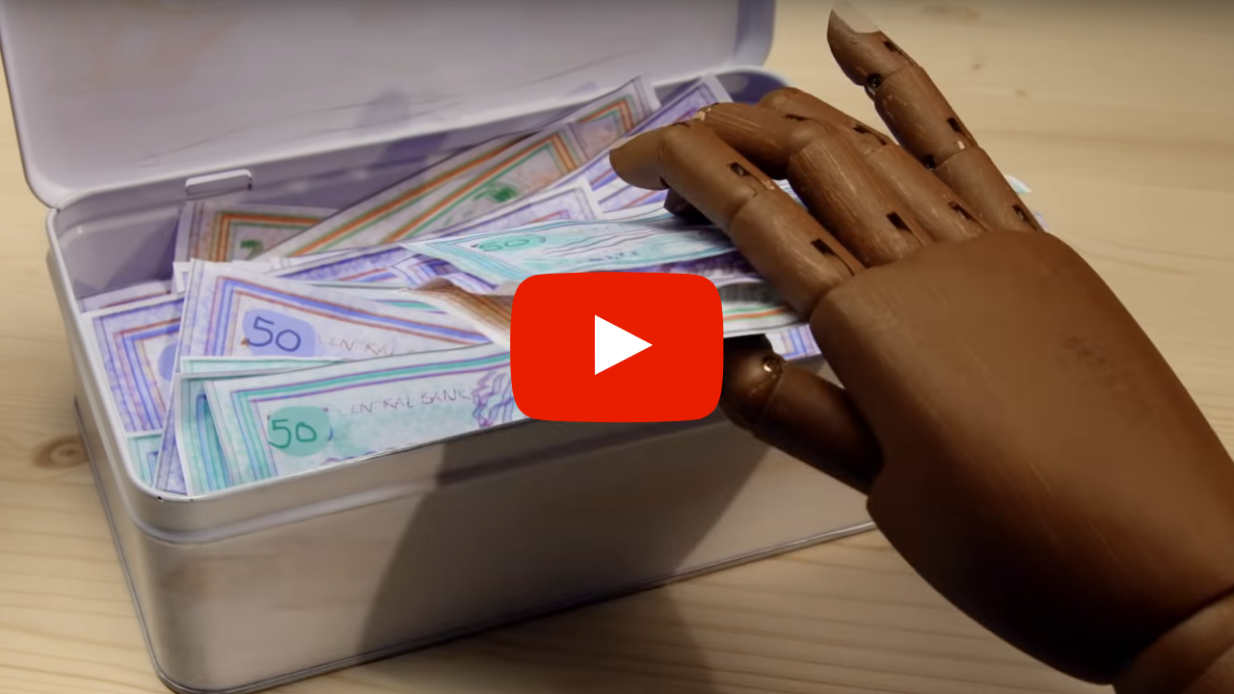
Notes:
I’d like to share a short video with you to illustrate how all of this comes together.
https://youtu.be/xGXOXcLuN2Q
NOTE: An internet connection will be required to play the video. We would recommend having an internet browser open with the video ready to go which you can easily open during the presentation.

Slide 7
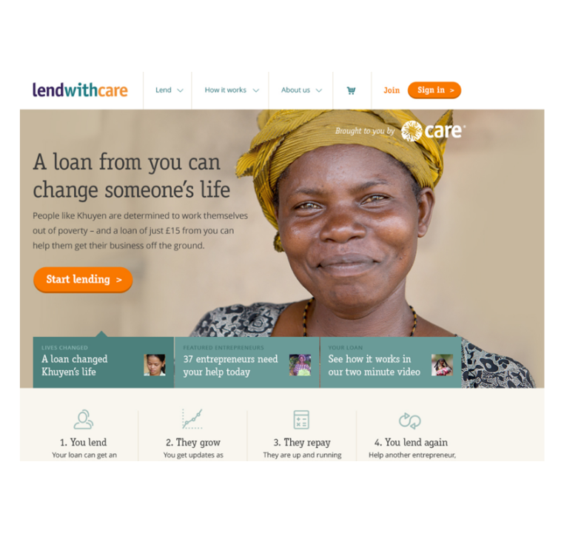
Our website homepage
Simply log on to www.lendwithcare.org where you can view profiles of entrepreneurs all over the world.
You can browse a range of different businesses and choose which entrepreneur or entrepreneurs you'd like to support.
Notes:
Here’s a snapshot of how the website looks.
You simply log on to www.lendwithcare.org where you can view profiles of entrepreneurs all over the world: in Malawi, Zambia, Zimbabwe and Rwanda in Africa, Pakistan, Palestine, the Philippines and Cambodia in Asia, and Ecuador and Peru in South America.
You can view their different businesses and chose which entrepreneur or entrepreneurs you'd like to support. You can invest towards the total, anything from £15 up to the full amount, and you can follow the progress of the entrepreneurs' growing business to see how their new source of income is helping to improve many different aspects of their lives.
The loan is then repaid to you over an agreed schedule, usually about 6-12 months and when the repaid loan is credited to your lendwithcare.org account, you can choose to withdraw the money, or recycle it into another loan and continue your support to entrepreneur after entrepreneur.
NOTE: Please keep an eye on the website to update the list of countries Lendwithcare is operating in.

Slide 8
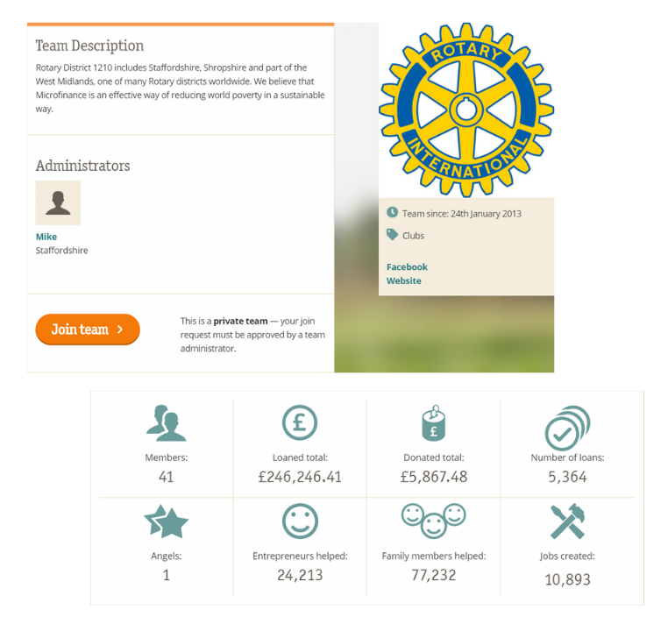
Lending teams
While you can support Lendwithcare as an individual, another way of getting involved is to set up or join a Lendwithcare team.
It’s a brilliant way of joining forces to see how much impact you and your team have made together!
Notes:
While you can support Lendwithcare as an individual, another way of getting involved is to set up a Lendwithcare team. This can be with your family, a club, or at your work!
Once you have registered with lendwithcare.org (as an individual), you can set up groups, or join existing ones, and start lending together. When you make a loan, you can then attribute it to the group(s) you have joined.
It’s a brilliant way of joining forces to see how much impact you and your team have made together. Your team page will show your achievements so you can see your collaborative efforts and the difference you’ve made.

Slide 9
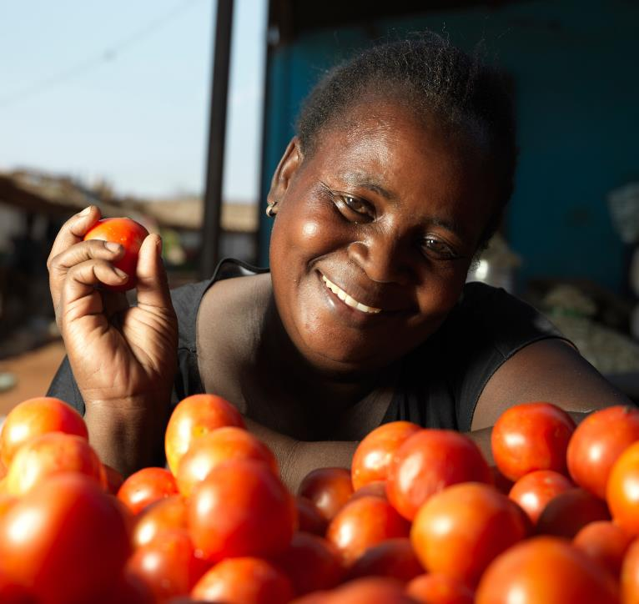
Elina Chipoka
Tomato Seller
Livingstone,
Southern Zambia
Support from lenders has helped Elina to expand her business and better provide for her family.
In the future, Elina hopes to use her plot of land to build her own house so she will no longer bear the burden of renting.
Notes:
I’d like to take a short moment to look at a few examples of real people who have received help through Lendwithcare.
Elina is a tomato seller from Livingstone in Zambia, who has been selling tomatoes to earn a living
She requested a loan to purchase a larger stock of tomatoes in bulk, which has helped her to increase her income to provide for her family.
In the future, Elina wants to continue saving so she has enough to build a house on a plot of land which she owns. Currently she has to rent a house for her family.

Slide 10
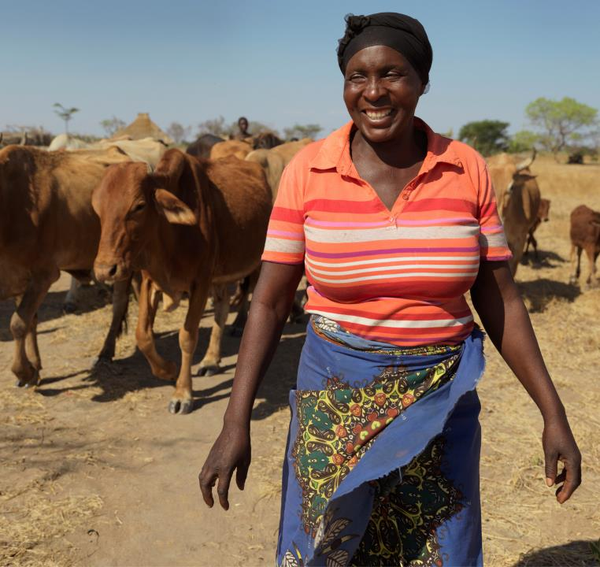
Florence Mukupa
Goat and Cattle Owner
Mabuyu Group, Southern Zambia
Support from lenders has helped Florence to overcome the loss of her husband and provide for her family.
The younger children are now able to go to school, increasing the likelihood of a brighter future for the whole family.
Notes:
This is Florence. She is a goat a cattle owner also living in Zambia. Sadly her husband passed away recently and now she is the only one looking after her large family.
Loans from Lendwithcare have helped Florence to start her business rearing goat and cattle and selling them to earn a profit. Her animals also provide milk for the family and milk to sell for a profit as well.
This support has helped Florence to provide for her family, ultimately helping her to feel more empowered and work towards overcoming the loss of her husband.

Slide 11
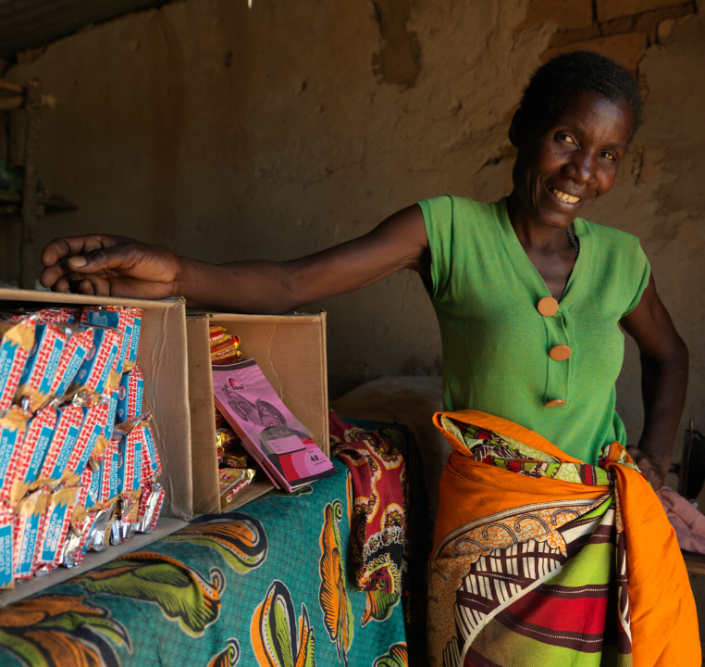
Supporting female entrepreneurs
Around 80% of entrepreneurs supported are women.
The majority of people living in poverty in the world are women, and women are disproportionately excluded from access to financial services.
Studies have shown that supporting women can have the greatest impact on poverty.
Notes:
Whilst Lendwithcare is not limited to women, over 80% of the entrepreneurs are women.
This is for two reasons: firstly, because the majority of people living in poverty in the world are women, and women are disproportionately excluded from access to financial services.
Secondly, studies have shown that supporting women can have the greatest impact, as they spend a greater percentage of their income on the welfare of their households than men.
So by enabling women to invest in sustainable livelihoods, they can help lift entire families and communities out of poverty.

Slide 12
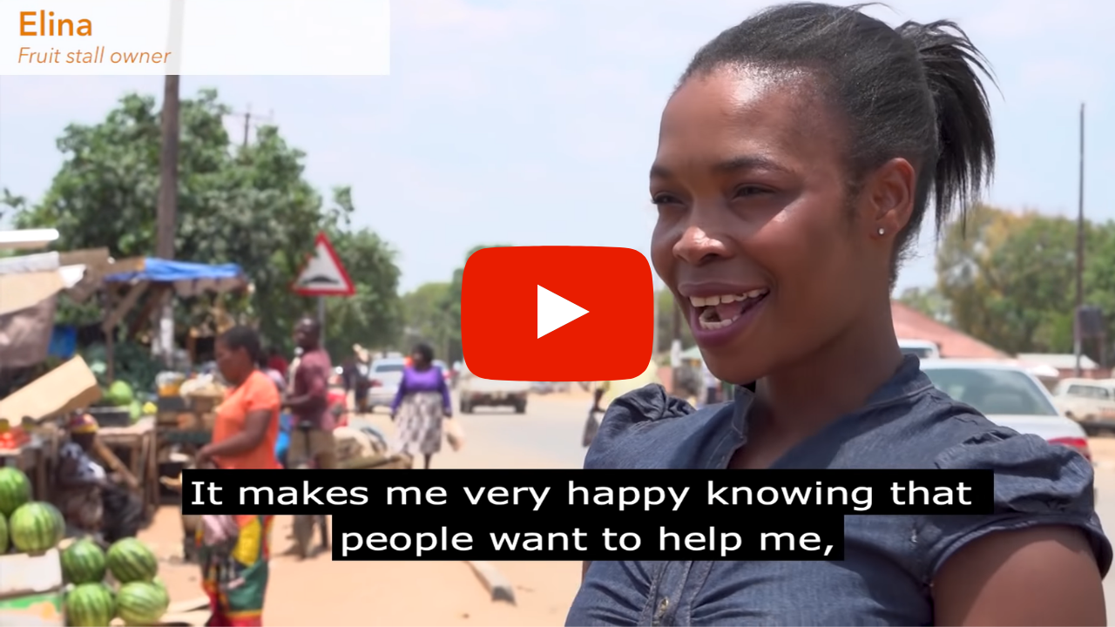
Notes:
This short video shows the fantastic impact that Lendwithcare has on the lives of women entrepreneurs in Zambia.
https://youtu.be/_HeWSX-K-Uk
NOTE: An internet connection will be required to play the video. We would recommend having an internet browser open with the video ready to go which you can easily open during the presentation.

Slide 13

Support from Rotary International
We receive exceptional support from Rotary clubs across the UK and Ireland.
To date we’ve had over 250 Rotary clubs sign up to Lendwithcare.
At the start of 2020 they had lent and re-lent more than £1 million between them.
Notes:
Lendwithcare is incredibly lucky to already receive exceptional support from Rotary.
To date, we’ve had over 250 clubs across the UK and Ireland sign up to Lendwithcare.
At the start of 2020, they have lent and re-lent more than £1 million between. An incredible milestone that we feel should be celebrated!

Slide 14
Multiplying the impact of Rotary International
£2,800 invested by the Rotary Club of Chatteris has resulted in over £11,000 loaned.
737 loans made since 2012…
2,418 entrepreneurs supported has benefited 8,129 family members and created 1,548 jobs to date.
Notes:
Here’s a great example of Rotary club who are making a difference through Lendwithcare.
£2,800 added in loans has been gradually re-paid and re-loaned and resulted in over £11,000 being loaned to poor entrepreneurs.
They have made a total of 737 loans since 2012.
..,and that has resulted in 2,418 entrepreneurs being supported, benefitting 8,129 family members and creating 1,548 jobs.
Not bad with an investment of £2,800!

Slide 15
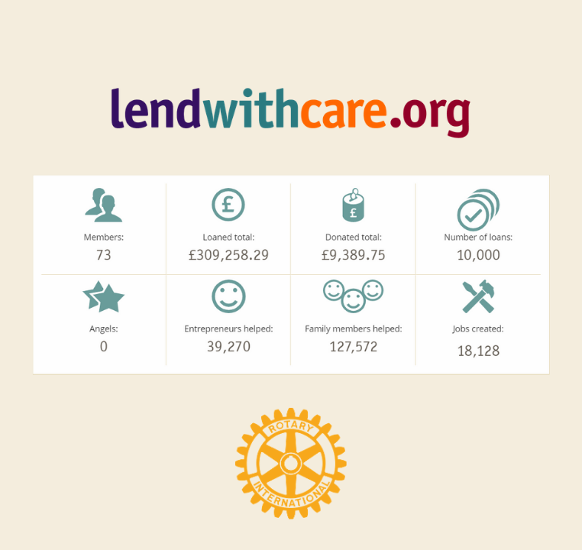
District 1080 Members
District 1080 is one of our biggest supporters.
Team members include individual Rotarians and over 30 different Rotary clubs.
We hope you join them by supporting Lendwithcare too!
Notes:
Supporting Lendwithcare is all about individuals and groups coming together to make an impact collectively.
District 1080 is a great example of Rotary clubs coming together to support Lendwithcare.
Their team has over 30 different Rotary clubs as well as individual Rotarians supporting personally as well.
We sincerely hope that you’ll join the amazing members of District 1080 by supporting Lendwithcare too.

Slide 16
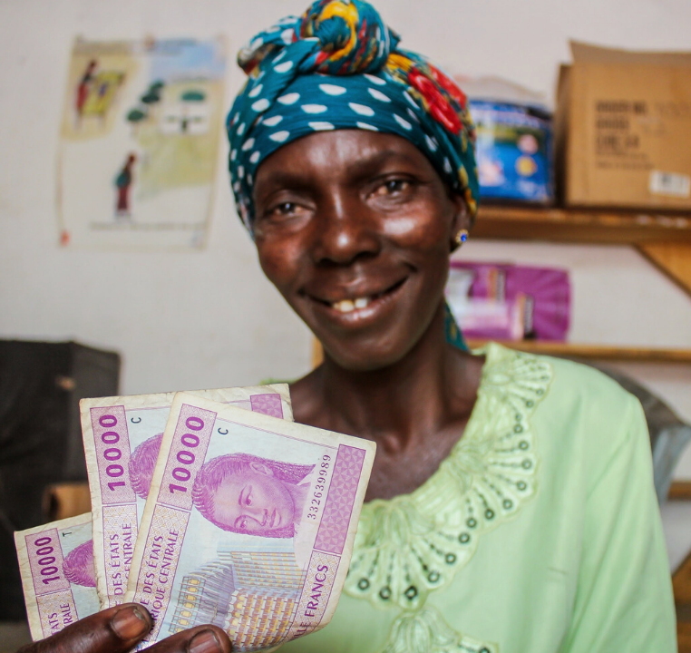
How can Rotary International help more?
Open a Lendwithcare account in the name of your club.
Support Lendwithcare with a donation from your club.
Choose entrepreneurs to support and start your journey as club supporting Lendwithcare.
Notes:
How can Rotary help more? We’d love it if you can get involved in the following ways:
Open a Lendwithcare account in the name of your club.
Support Lendwithcare with a donation from your club.
Choose entrepreneurs to support. As you start receiving re-payments you can start choosing more entrepreneurs to support.
Encourage other Rotarians to join Lendwithcare as individual lenders.
Talk about your activities/loans on social media, in newsletters and on your Club website
You can also set up a lending team for your District.

Slide 17
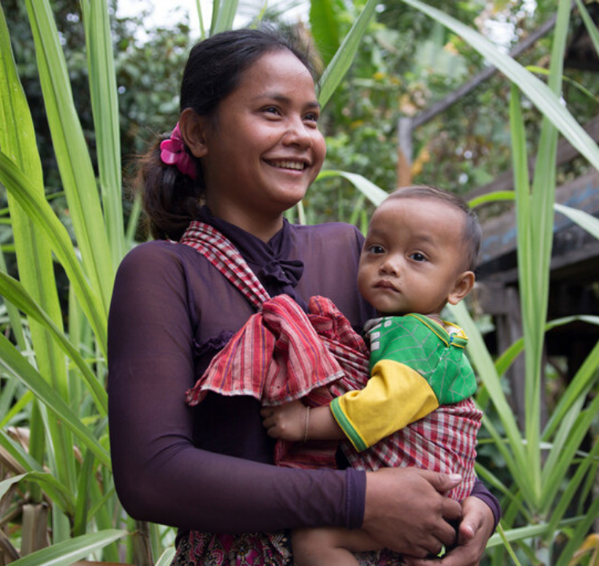
Make a loan, change a life with Lendwithcare
Thank you. Please visit the website to find out more!
Notes:
Right now there are 60,000 people across the UK just like you who are helping nearly 130,000 poor entrepreneurs like Elina and Florence, all around the world every day.
So far our amazing supporters have helped to lend an incredible £27million and the figure is growing every day.
I sincerely hope you will all join us. You can find out more by going to the website lendwithcare.org.
Thanks for listening.

